Slide 1
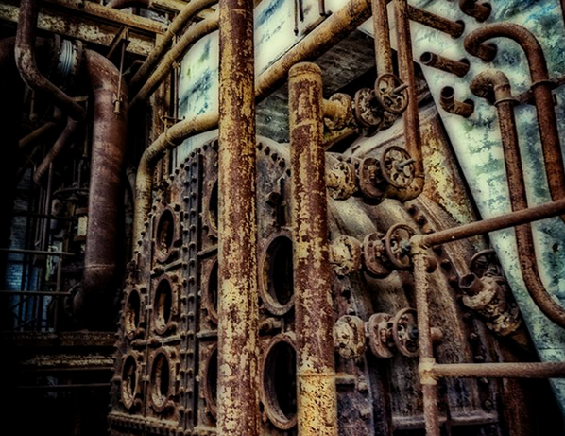
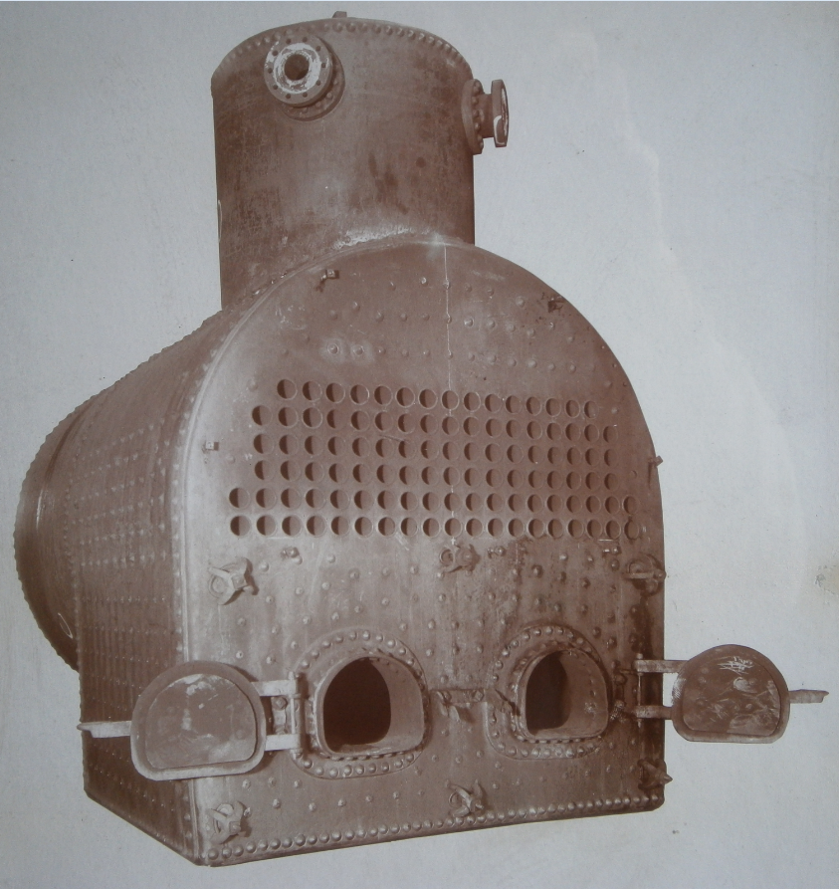
J. D. Cousins
Types of Equipment
Exchangers
Vessels
Columns
Skid packages
Wet surface fluid coolers
Celebrating 150 Years In Business
Time Line:
Howard Iron Works was established in 1847
J.D.Cousins and Sons was established in 1867
J.D.Cousins and Sons acquired Howard Iron Works 1904 and moved to our present location
J.D. Cousins and Sons name was changed to J.D.Cousins, Inc in 1977
J.D.Cousins acquired Hoffman Process 2014

Slide 2
In 2014 J.D. Cousins acquired the shell and tube product line of Hoffman Process, Inc., of Bridgeville, PA

Slide 3
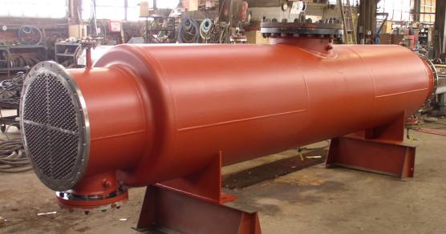
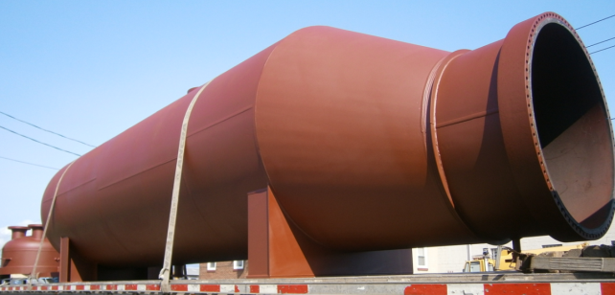
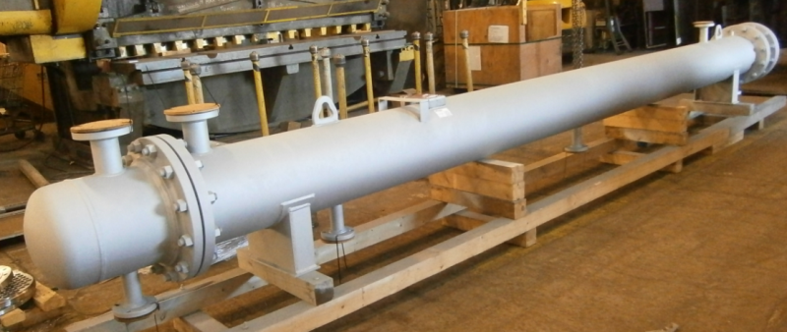
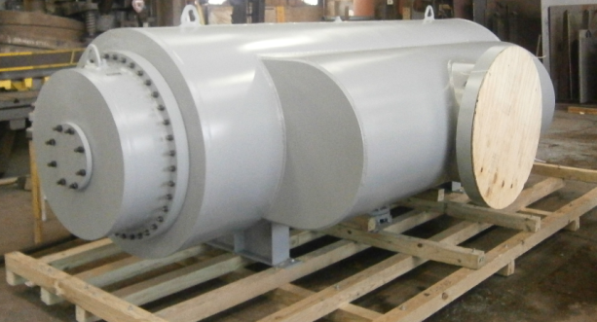
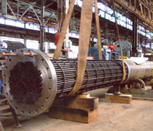
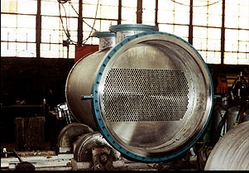
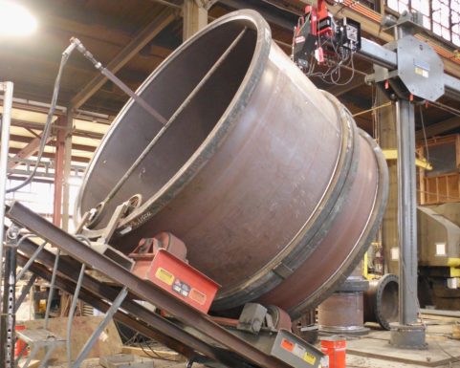
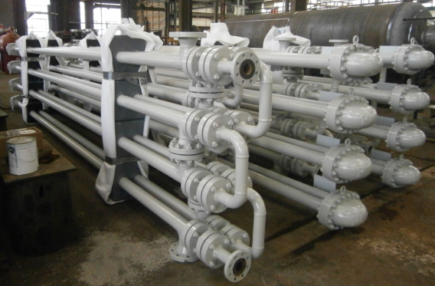
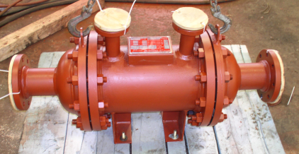
Heat Exchangers
Codes:
ASME Sect. VIII Div 1 (U and R stamp )
TEMA C,B and R
API 660,618 and 614
PED
CRN

Slide 4
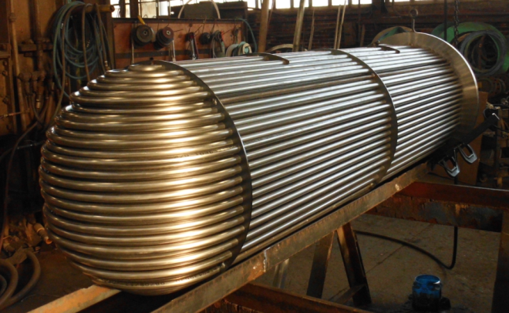
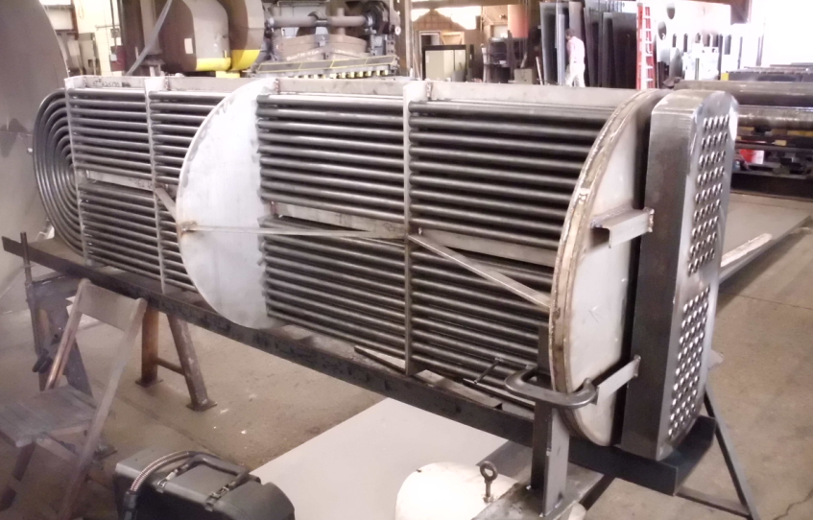
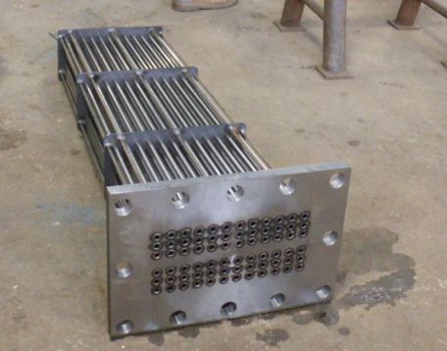
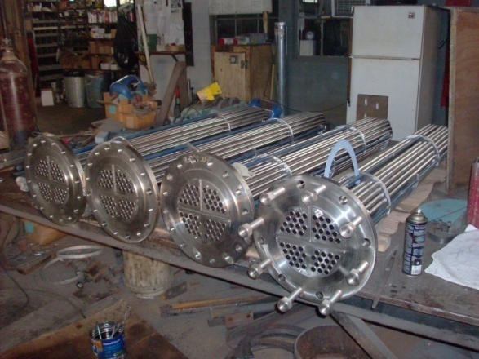
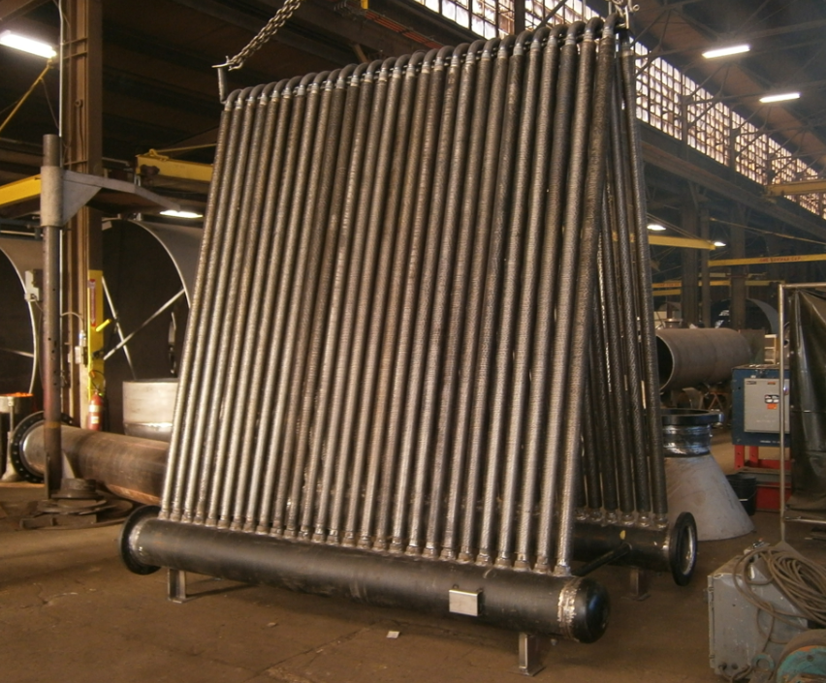
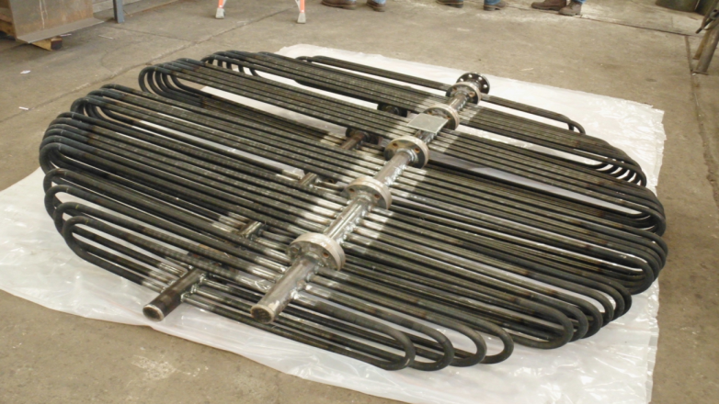
Heat Exchanger Bundles

Slide 5
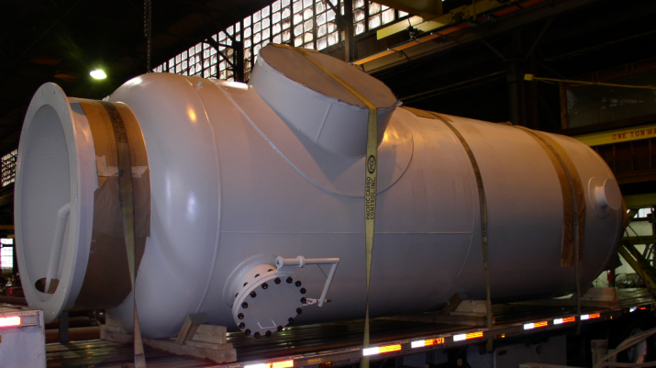
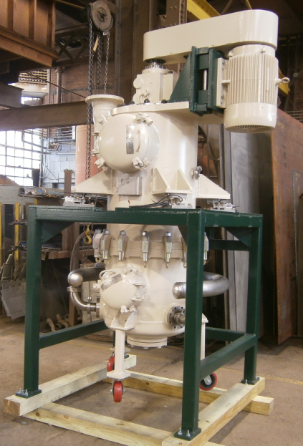
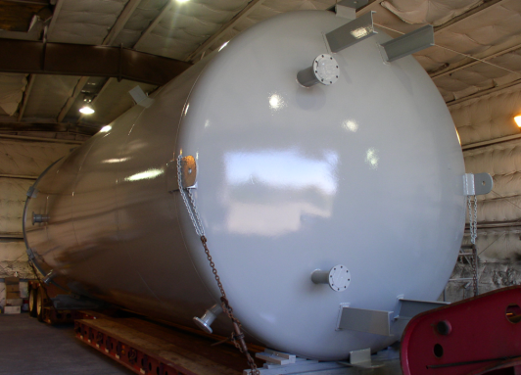
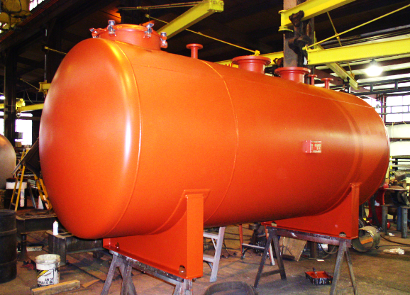
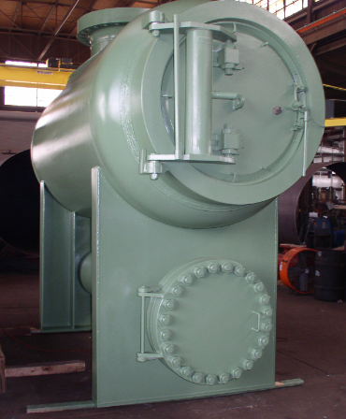
Pressure Vessels
TYPES:
Storage Tanks
Vacuum Chambers Separators
Pulsation Bottles
Silencers
Flash Tanks
Jacketed half pipe Jacketed dimpled tanks Mixing tanks
Reactors
Atmospheric tanks Autoclaves ( quick opening doors)
Sterilizers

Slide 6
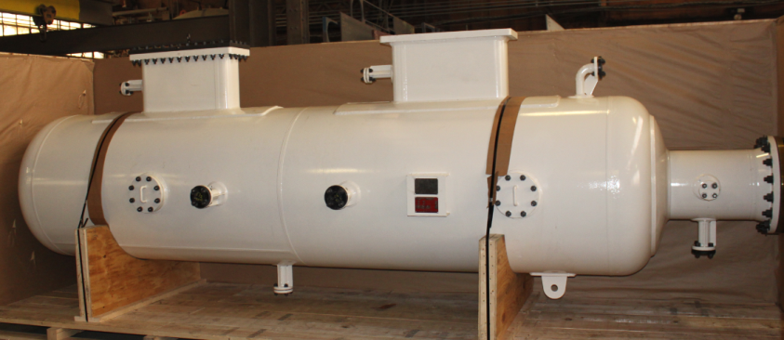
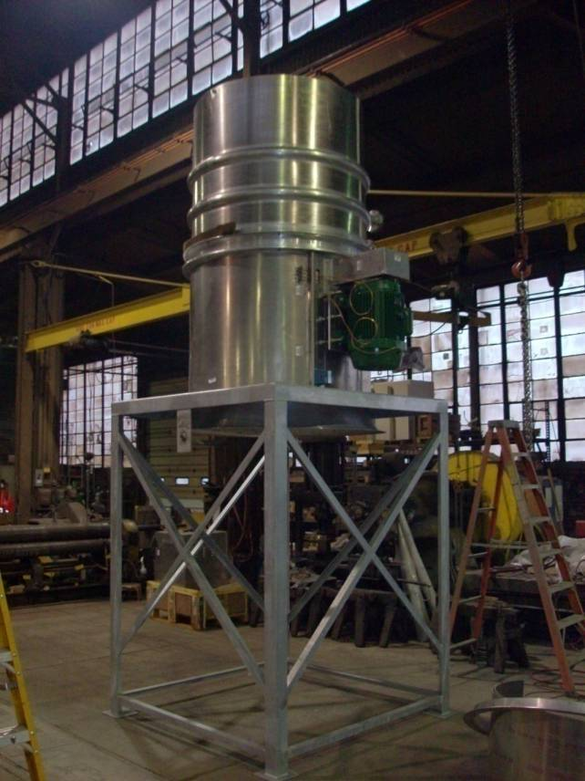
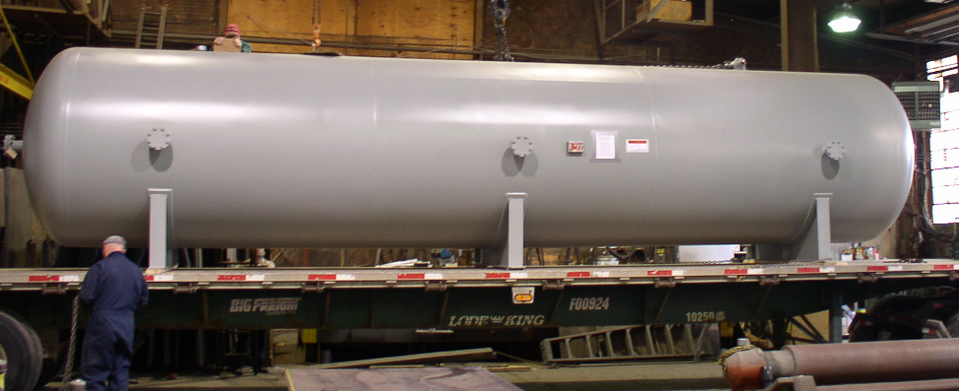
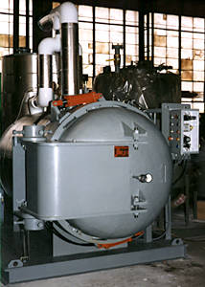
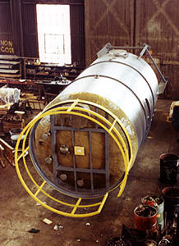
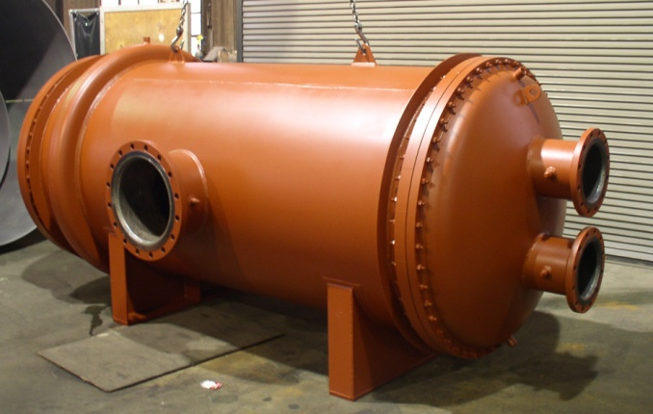
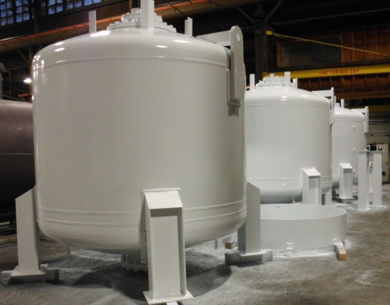
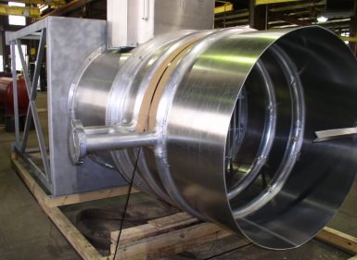
Pressure Vessels
Codes:
ASME Sect. VIII Div 1 (U and R stamp)
API 620 and 650
NACE
PED
CRN

Slide 7
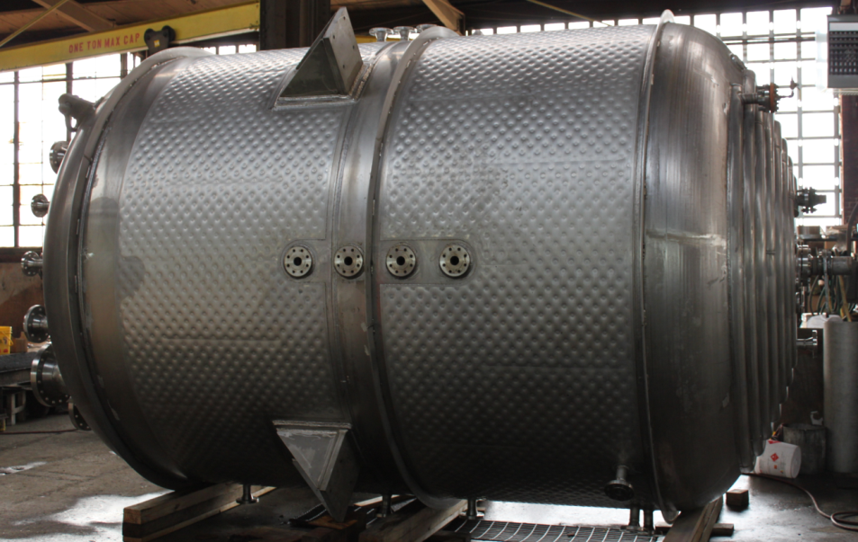
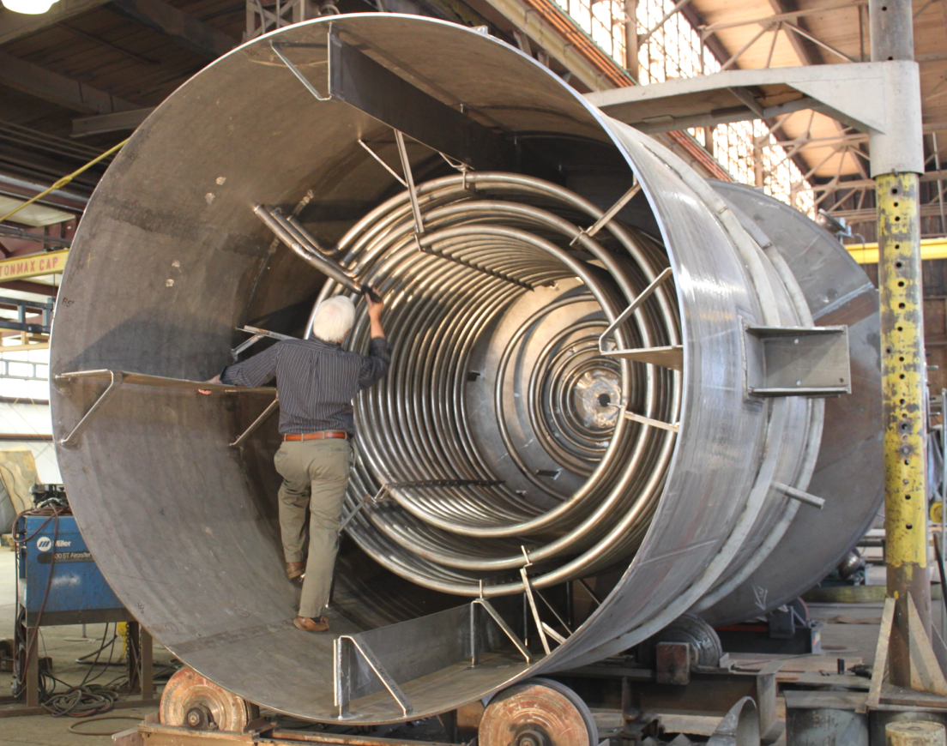
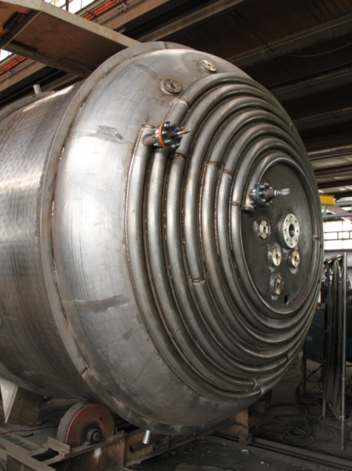
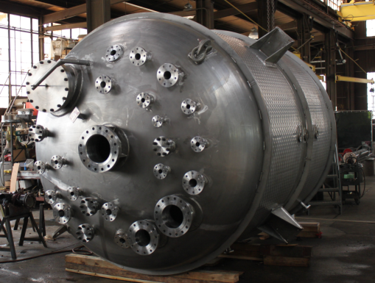
Pressure Vessels
Thermal Transfer Components
Half pipe
Welded on Dimpled
Bolted on Dimpled
Laser
Pipe coils

Slide 8
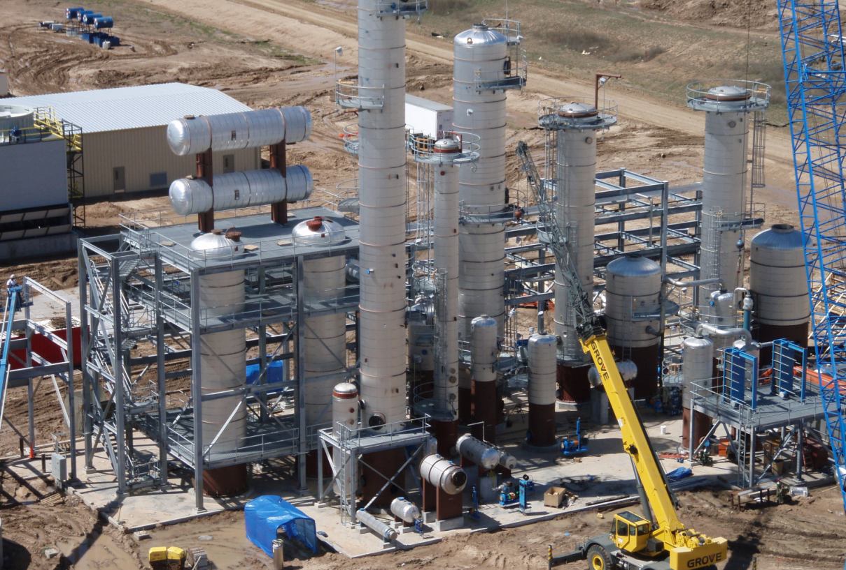
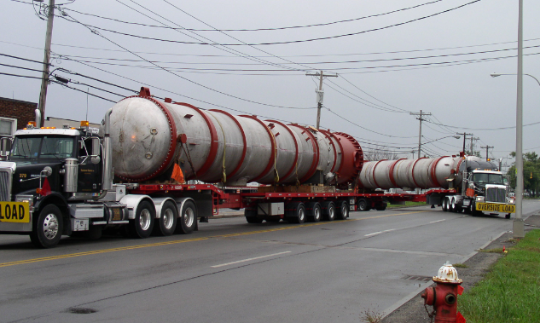
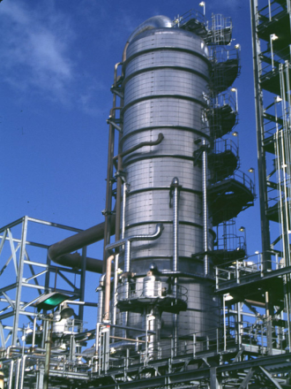
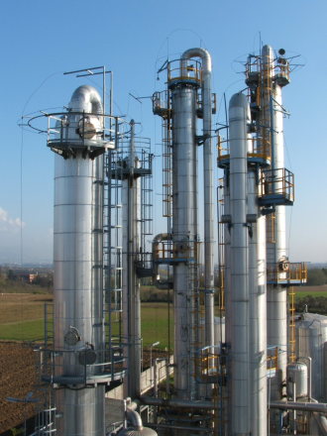
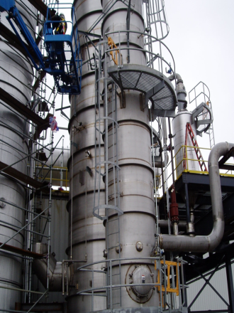
Distillation Columns
Distillation Process
Batch, Continuous, Stripping, Azeotropic, Extractive, Rectification
Codes:
ASME Sec. VIII Div 1 (U and R stamp)

Slide 9
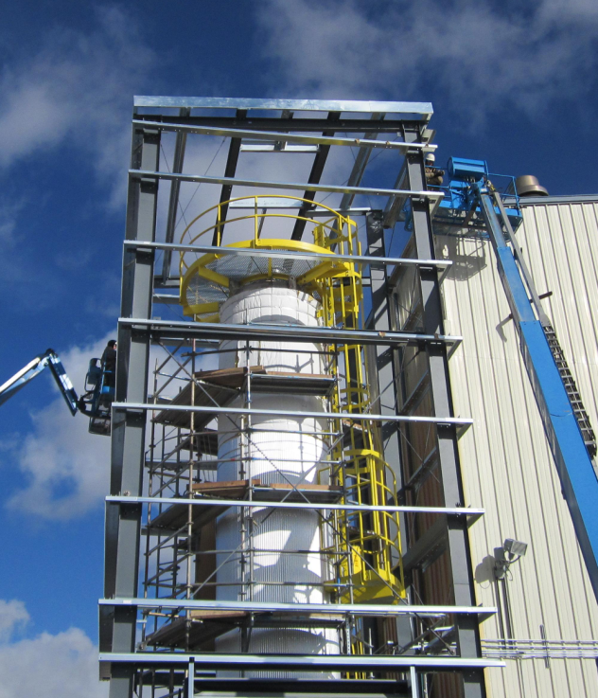
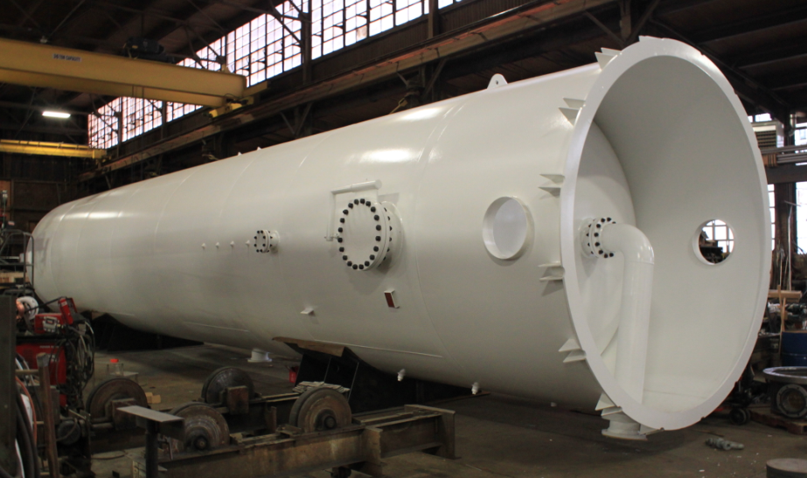
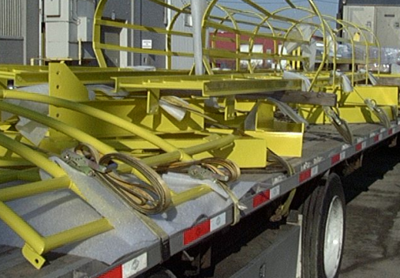
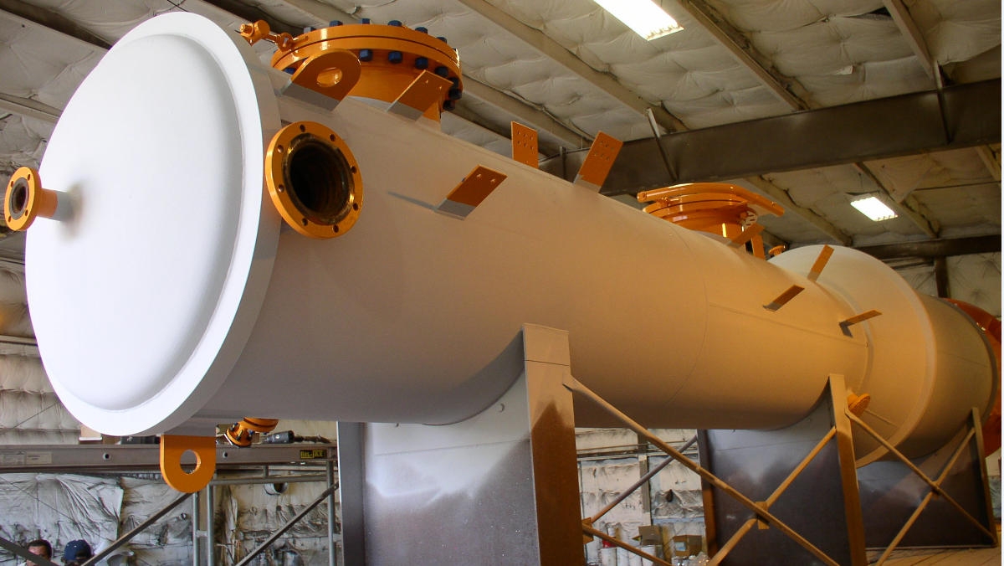
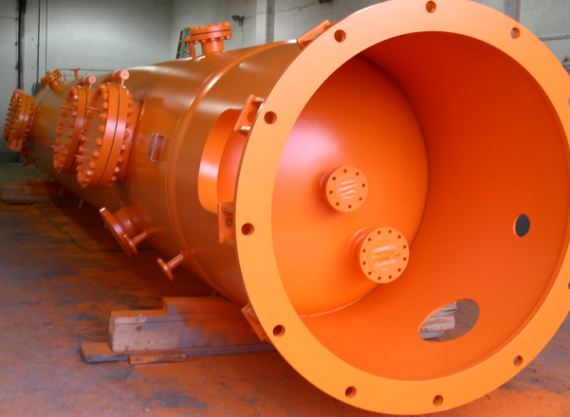
Distillation Columns

Slide 10
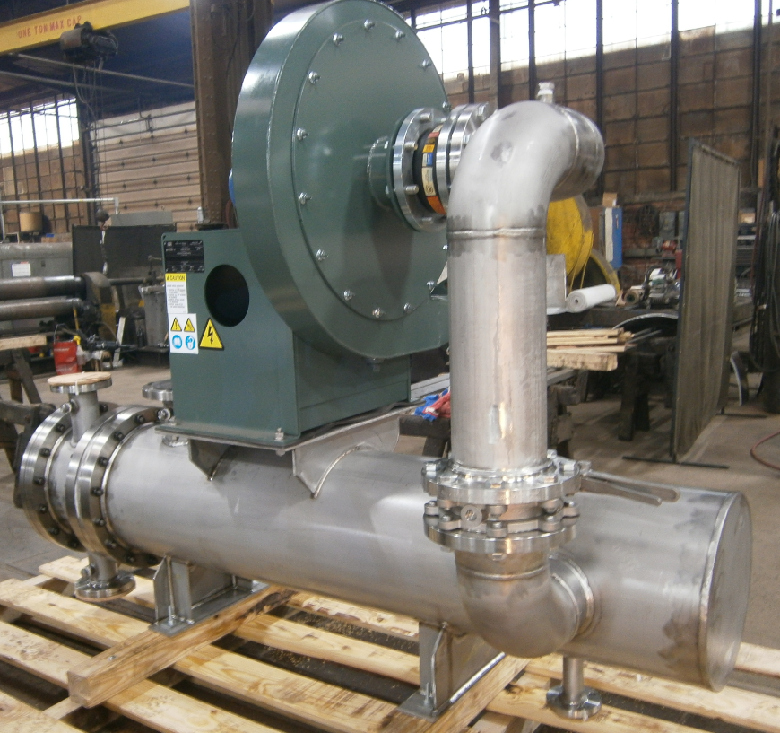
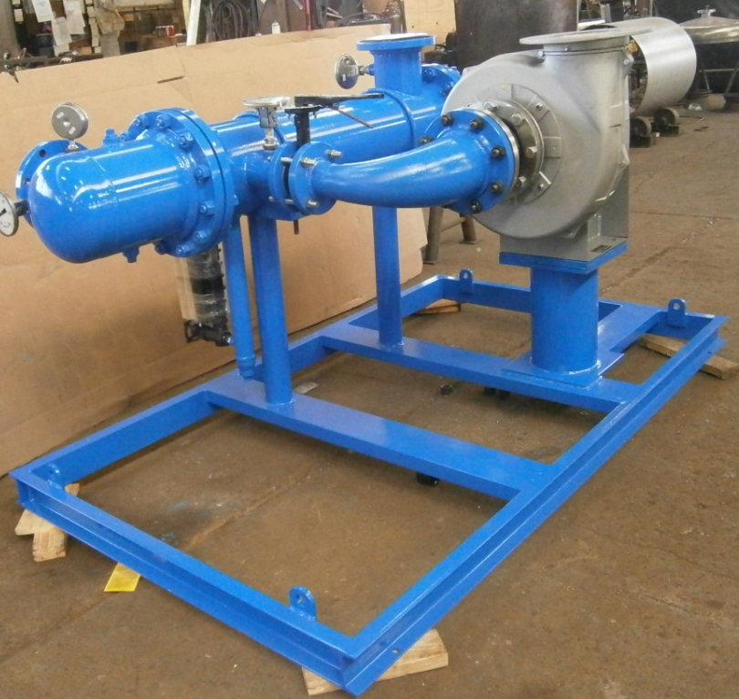
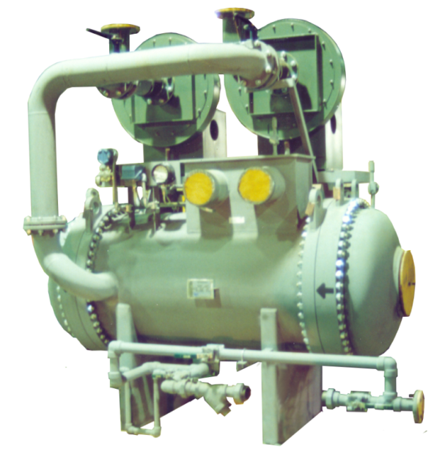
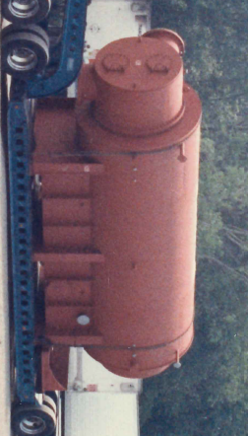
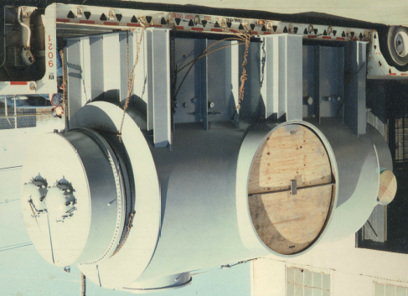
Surface Condenser

Slide 11
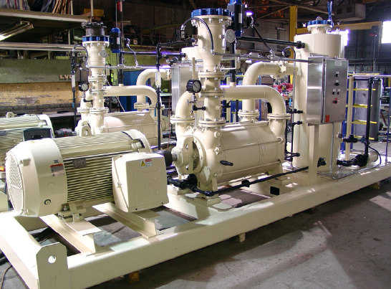
Surface Condenser Options
Liquid Ring
Vacuum Pumps

Slide 12
EconoCool Wet Surface Fluid Cooler
Any fluid can be cooled such as steam, hydrocarbons, etc.
Furnace Water Cooler

Slide 13
EconoCool Modular Unit Wet Surface Fluid Cooler

Slide 14
J. D. Cousins
Howard Iron Works of Buffalo, New York
Gears, Pulleys, Furnaces, Fire Hydrants; Machinery for: Power Transmission, Nut Making, Metal Bending, & Forging
We would appreciate the opportunity to fabricate your equipment needs. Call 716-824-1098
Or email mdd@jdcousins.com
for a quotation.
Thank you.

